Slide 1
Malware – A BILLION DOLLAR BUSINESS
Liviu ARSENE. Senior e-Threat Analyst

Slide 2
agenda
NCSAM
2016 Cyber-threat Landscape
Malware-as-a-service
PPP

Slide 3
NCSAM
Collaboration with Europol, Greek Police, etc.
Last NCSAM week dedicated to mobile threats
Cross-regional campaign
Free mobile security solutions

Slide 4
THE MALWARE LANDSCAPE
CONVENTIONAL THREATS, KNOWN FROM THE PREVIOUS YEARS
Banker Trojans (Zeus, Carberp, SpyEye)
Information Stealers (especially password stealers)
Spam-sending Trojans
NEW THREATS
RANSOMWARE
EXPLOIT KITS
ADVANCED PERSISTENT THREATS

Slide 5
THE MALWARE LANDSCAPE
60% of targeted malware aims at SMBs
25% of all malware is virtual machine aware.
Note: Virtualization alone is not the key to security.

Slide 6
MALWARE NOW AVAILABLE AS A SERVICE
Malware Creation Toolkits
Selling for between $100 - $10,000; some are free
Hourly updates
Technical support for “customers”

Slide 7
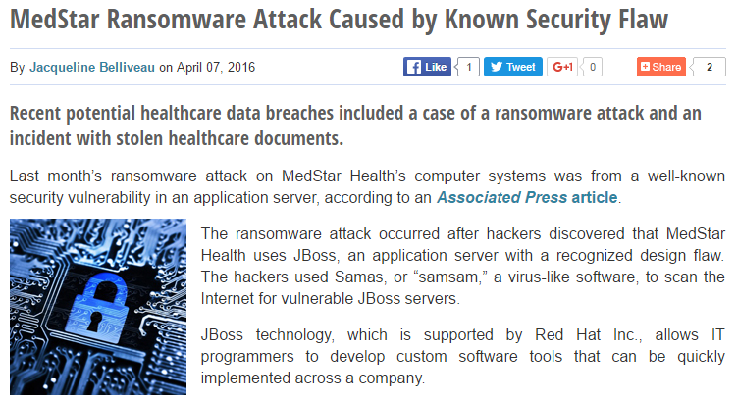
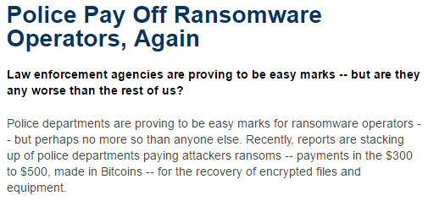
Targets
Notes:
3 Examples with animation

Slide 8
Malware – A BILLION DOLLAR BUSINESS
1,425% ROI *
For every dollar spent, hackers make 1,400 times more
Example: Cryptolocker ($28 million in 4 months)
CryptoWall: 380 million in one year
$$$
*source: the RAND Report

Slide 9
Cybercrime Global Costs

Slide 10
Some issues on PPP investigations
LEA
Goal is to find and arrest the perpetrator and bring him to justice
Secrecy towards the adversary
Finding one proof/evidence
Searches limited by data protection
Formal chain of evidence
Supervised by prosecutor
Medium expertise in forensics
Restrained capacity in analysis
Speed is not the main goal
Private Sector
Goal is to identify and protect additional victims
Secrecy towards the adversary
Finding all evidences
Few data protection constraints
Access to correlated data and intel
High expertise in forensics
Scalable capacity in analysis
Speed is essential
9
Notes:
LEA – Law Enforcement Agencies
Although we had some pretty good success in our joint investigations in Romania, in general, the partnerships between law enforcement agencies and the private sector do not usually work as expected. See the slide for reasons.
There are several events/conferences and so on where we discuss the advantages of working together (private and public sector), but when it comes to actual work, LEA does not share information with the private sector (as to not reveal investigations in progress) and if the private sector brings proactive information, cases are not always open. It’s a flawed circle that needs to be addressed. Not to mention jurisdiction issues and most importantly speed.

