Slide 1
About the NIS directive
Dan Tofan | NIS Expert @ ENISA
Bucharest 03.10.2016 CERT-RO

Slide 2
NIS directive – the context

Slide 3
NIS directive
Scope: to achieve a high common level of security of NIS within the Union (first EU regulatory act at this level).
Status: ADOPTED August 2016. Deadline: 9 May 2018 (21 months).
Provisions:
Improved cybersecurity capabilities at national level
Increased EU-level cooperation
Obligations for operators of essential services (OES) and digital service providers (DSP)
Additional info and deadlines:
Q&A: http://europa.eu/rapid/press-release_STATEMENT-16-2424_en.htm
Press release: http://europa.eu/rapid/press-release_MEMO-16-2422_en.htm

Slide 4
Improved cybersecurity capabilities at national level
adopt a national NIS strategies to include:
Strategic objectives, priorities and governance framework
Measures on preparedness, response and recovery
Cooperation methods between the public and private sectors
Awareness raising, training and education
designate one or more national competent authorities.
designate one or more Computer Security Incident Response Teams (CSIRTs):
Monitoring incidents at a national level
Providing early warning, alerts
Incident reponse

Slide 5
Increased EU-level cooperation
Creates first EU Cooperation Group on NIS, for the following:
Provide guidance for CSIRTs Network
Assist Member States in NIS capacity building
Support Member States in the identification of operators of essential services
Evaluate national NIS strategies and CSIRTs (on voluntary basis)
Creates a EU National CSIRTs Network, to do the following:
Information sharing
Coordinated incident response
Cross-border incident handling

Slide 6
Obligations for MS on OES
Assess the provision of essential services taking into account sector specific, cross sectoral and cross border factors dependent on network and information systems, for the maintenance of critical societal and economic activities.
Establish objective quantifiable criteria and thresholds to identify and list critical services, that will allow the identification of operators of essential services. Review and update the list regularly (at least every two years).
Adopt risk management measures to identify, prevent, detect, handle and mitigate incidents.
Adopt national guidelines determining the circumstances to report incidents.
Notes:
NIS directive applicable only to large and medium enterprises!

Slide 7
Obligations for MS on DSP
Preventing risks: Technical and organizational measures that are appropriate and proportionate to the risk.
Minimum security measures.
Mandatory incident notification: The measures should prevent and minimize the impact of incidents on the IT systems used to provide the services.
Notes:
Light touch approach to be applied for DSPs!
NIS directive applicable only to large and medium enterprises!

Slide 8
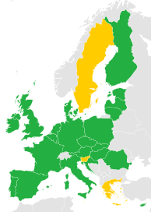
The NIS Directive
National
Cyber
Security
Strategies
Strategic
Cooperation Group
Transport
Cloud Computing Services
Digital Service Providers
Operators of Essential Services
Energy and Drinking
water supply and
distribution
EU IMPLEMENTING ACTS
Incident Reporting
NATIONAL LEGISLATION
Online Marketplaces
Security Requirements
Healthcare
Search Engines
Banking and Financial
market infrastructures
Tactical/Operational
CSIRT Network
Digital Infrastructure
(DNS, IXPs, TLD)
Notes:
In terms of incident reporting and security measures provisions these are going to be enforced at national level through EU implementing acts for DSPs and through national legislation for OES.

Slide 9
NIS directive - TIMELINE
August 2016 | - | Entry into force
February 2017 | 6 months | Cooperation Group begins tasks
August 2017 | 12 months | Adoption of implementing on security and notification requirements for DSPs
February 2018 | 18 months | Cooperation Group establishes work programme
9 May 2018 | 21 months | Transposition into national law
November 2018 | 27 months | Member States to identify operators of essential services
May 2019 | 33 months (i.e. 1 year after transposition) | Commission report - consistency of Member States' identification of OES
May 2021 | 57 months (i.e. 3 years after transposition) | Commission review

Slide 10
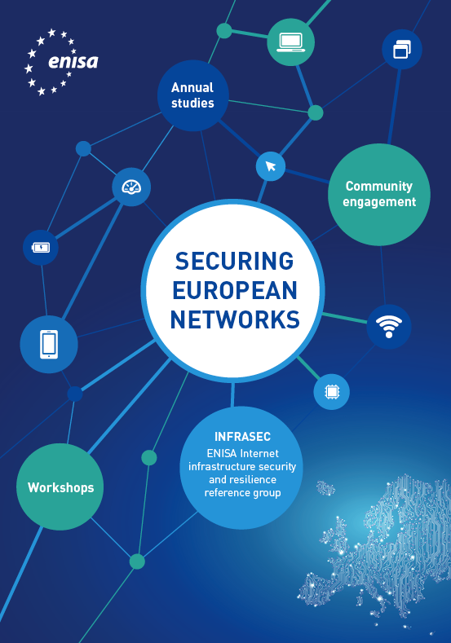
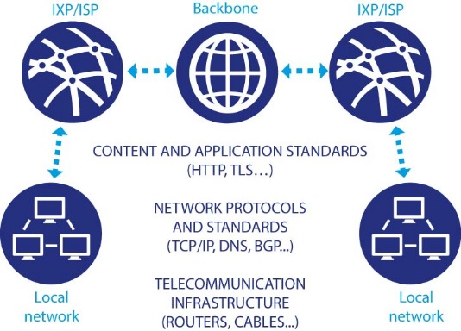
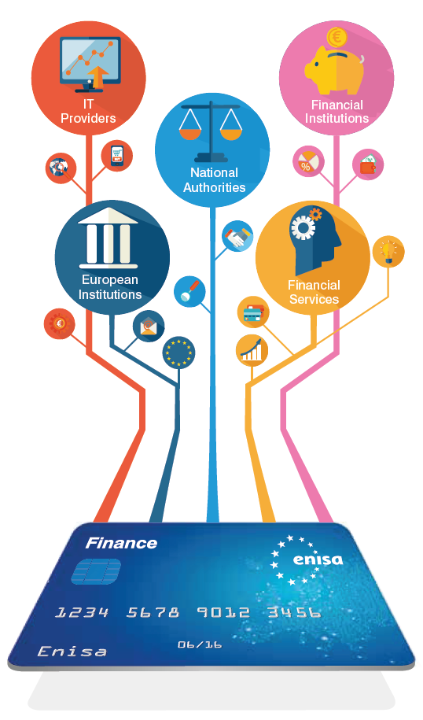
CII sectors covered by ENISA
Telecom/Internet Infrastructures
Energy
NCSS
ALL COVERED BY THE NIS DIRECTIVE !!!
Transport
eHealth and Smart Hospitals
Finance
Notes:
Perfect match of the NIS directive with ENISA’s activities!!!
Even though the NIS directive does not cover the TELECOM sector, certain services offered by telecoms are covered by NIS: DNS, cloud, IXPs. In most of the cases they will have to follow both Telekom Framework and NIS directive.

Slide 11
General role of ENISA
Assistance for MS and the EU Comm by providing its expertise and advice and by facilitating exchange of best practices.
Assistance for MS in developing national NIS strategies.
Participation within the EU NIS Cooperation Group (CG).
Support EU Comm in developing security and notification requirements for ESP and DSP.
Assistance for MS in developing national CSIRTs.
Elaborate advices and guidelines regarding standardization in NIS security, together with MS.

Slide 12
ENISA projects 2016
Guidelines for implementing incident notification – DSPs.
- Assist EC (by providing input for the implementing acts) and MS (by providing guidelines) in incident notification requirements for DSPs.
Guidelines for implementing security measures – DSPs.
- Assist EC (by providing input for the implementing acts) and MS (by providing guidelines) in implementing minimum security measures for DSPs.
3) Identification of OES
Preparatory work on approaches taken by MS in identifying ESOs.

Slide 13
ENISA projects 2016
Security requirements for Electricity power supply operators
Stock taking of existing security good practices in the energy sector across EU
5) Preparatory work for CSIRT network secretariat
Guidelines for national CSIRTs on physical security, business continuity and staffing.
CSIRT network maturity guidelines

Slide 14
Some facts for MS
EU will go from voluntary (over 60%) incident reporting to mandatory.
Almost 50% of the MS have difficulties in identifying their operators; support is needed.
More than 70% consider that significant investments are needed.

Slide 15
Thank you

