Slide 1
CENTRALIZING INCIDENT RESPONSE RSA NetWitness
Brana Nikolajevic
Sales Specialist / Territory Manager
Threat Detection and Response
RSA NetWitness

Slide 2
Compromise is inevitable
Goal should be to detect and respond to attacks to minimize loss and damage.
Limit attacker free time inside your network.

Slide 3
WHAT TO DO ABOUT IT
Tools that provide visibility / forensic data are essential for detection and response:
Logs, Packets, Endpoint, Threat Inteligence
Ability to spot anomalous / suspicious activity and investigate
Ability to pivot and see the whole picture of the attack
Ability to response timely

Slide 4
Centralizing Incident Response Teams
SOC:
Security Operation Center
Better Detect, Investigate and Respond to Security Incidents
CIRC:
Critical Incident Response Center
CIRT:
Computer Incident Response Team
CERT:
Computer Emergency Response Team
SIRT:
Security Incident Response Team
Notes:
Many RSA customers are centralizing incident response teams and building out the security Incident response function. Generally speaking, this function resides in the CISO organization. EMC has its own specialized Incident Response team and it is called the Critical Incident Response Center (CIRC). But there are other names as SOC, CIRC, CIRT, CERT and SIRT. The end goal of all these teams is to Better detect, investigate and respond to security incidents.

Slide 5
Security Incidents Go Unnoticed
Unnoticed Incidents Will Lead to Data Breaches
Lack of
Framework
and
Alignment
85% of respondents
say there is no
prioritization
75% of breaches
compromise systems
in days or less
Only 25% of breaches are
discovered
in days or less
$5.4M is the cost
of a data breach
in US
Notes:
But as customers build out security incident response teams, there are issues. Security incidents are going unnoticed. Many times breaches take longer and by that time data has already been compromised. When a data breach happens, the typical cost is about $5.4M in the US. There is a need for process framework and alignment in the security operation center.

Slide 6
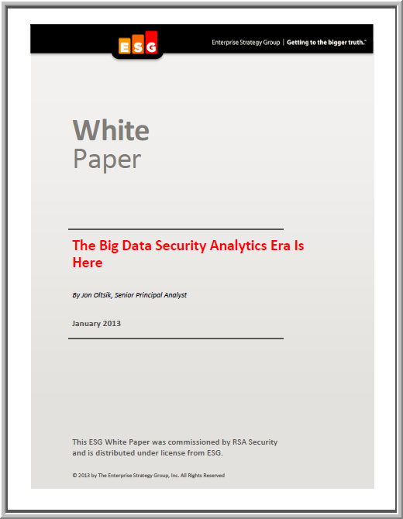
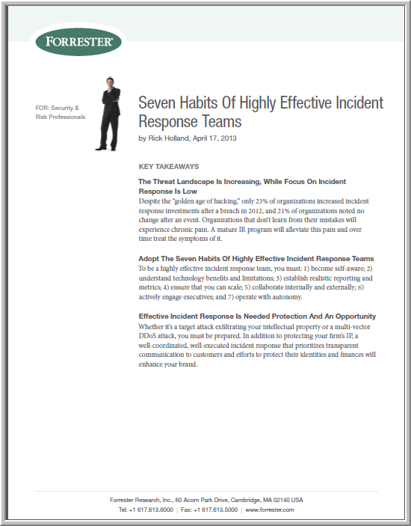
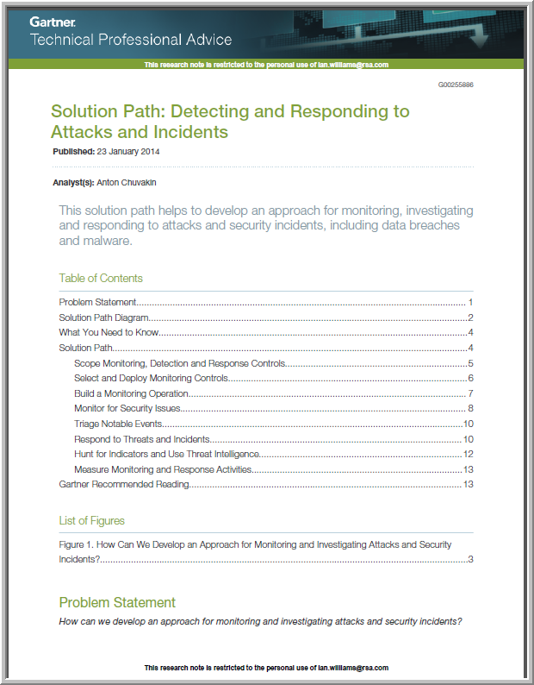
Industry Viewpoints
ESG - Security Incidents Unnoticed
Too Many Non-Integrated Tools
Too Many Manual Processes
Lack of Staff
Forrester – Effective Habits of Incident Response
Realistic Reporting & Metrics
Scalable
Collaborate
Gartner – Detect & Respond to Security Incidents
CISOs need to put in place incident response process with technology
Notes:
Several different analysts have weighed in on building out security incident response team. The issues highlighted include too many non-integrated tools, too many manual processes and lack of staff. As a matter of fact Forrester said that an incident response team needs to be scalable and collaborate effectively with realistic reporting and metrics. Gartner said that a CISO needs to really think about the process framework 1st before investing in technology and putting in place a dedicated staff. If the process framework is not thought through 1st, then the investments in SOC will go to waste.

Slide 7
Why Framework and Alignment?
Improve Response Readiness and Be Prepared
Collaborate Internally and Externally
Repeatable Ongoing Business Process
Learn and Refine
Measure Effectiveness of the Program
Prioritize against business context
Notes:
If a Framework and Alignment is in place for a SOC, here are the benefits realized.

Slide 8
RSA NETWITNESS
Flexible Integration (Api)
Capture, enrich and analyze data from across your network
Visibility
Behavior-based Analytics
Action
Analysis
PACKETS
LIVE
LIVE
Capture Time Data Enrichment
LOGS
LIVE
Incident Management
Compliance Reporting
Cloud
Real Time Detection
ENDPOINT
ENRICH
Archiving
On Prem
Investigation
Session Reconstruction
NETFLOW
Advanced Analytics
Endpoint Analysis
RSA LIVE
Threat Intel | Biz Context
Rules | Parsers | DS Models
Reports | Feeds
Powered by RSA Research, Incident Response & Engineering
Notes:
RSA has unparalleled data collection capabilities that provide the ability to capture data from across your network and enrich it live with intelligence metadata that speeds analysis.
And that feeds into both real-time and historic analytics platform. Our real-time analysis is able to detect and alert on attacks and compromises.
Historic analytics in the Pivotal Hadoop-based security warehouse enable us to deliver ongoing detection of covert channels.
And finally, we provide cost-effective compliance archiving.
All of which gives you the end-to-end, enterprise visibility you need to detect and take action against the attackers in your network.
API flexibility allows RSA Security Analytics to form heart of security ecosystem
Integrates with other security tools such as SIEM, IDS/IPS, firewalls, Splunk, FireEye, etc.
Integrate asset criticality and business context data from RSA Archer; data discover from RSA DLP, endpoint visibility from RSA ECAT
Open interface for access and transformation of collected data

Slide 9
VOICE OF THE CUSTOMER
“We switched on Security Analytics (NetWitness) and a lot of things suddenly started lighting up, just like a Christmas tree.”
Jason Haward-Grau, MOL Group CISO

Slide 10
Compromise is inevitable
Goal should be to detect and respond to attacks to minimize loss and damage
Limit attacker free time inside your network

Slide 11
WHAT TO DO ABOUT IT
Tools that provide visibility / forensic data are essential for detection and response
Logs, Packets, Endpoint, Threat Inteligence
Ability to spot anomalous / suspicious activity and investigate
Ability to pivot and see the whole picture of the attack

Slide 12
Capture Time Data Enrichment
LIVE
Enriches data right at time of capture making it much faster and more valuable for analysis and investigation
Seconds to respond in a time of crisis
Inspect every network session, log event, and flow for threat indicators
Most robust meta data (over 200)
Enables rapid alerting and investigations
Session based details to lead the analyst to the right answer
Fastest Retrieval & Reconstruction
Maintains the link between the sessionized data and the raw data
Virtual, Physical and/or SW
Capture Time Data Enrichment
Parsing and Metadata Tagging
Add’l Context
ENRICH

Slide 14
RSA NETWITNESS SECOPS
Framework & Alignment
RSA NetWitness SecOps provides a framework to prepare, investigate and respond to threats by aligning people, process and technology.

Slide 15
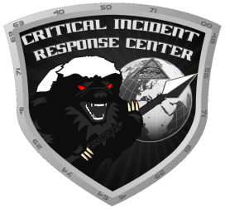
Leverage Best Practices
NAMING &
TERMINOLOGY
RESPONSE
PROCESS
PRACTITIONER
VIEW
25+
CIRC
VERIS
Framework
ENGINEERED AS PER THE EXPERTISE OF INDUSTRY AND PRACTITIONERS
Notes:
When developing SecOps, RSA leverage industry best practices around naming and terminology, process and took a practitioner view (EMC CIRC + 25 other CIRCs).

Slide 16
RSA Netwitness SecOps
Domain
Process
People
Technology
Framework & Alignment
RSA NW SecOps
Incident
Response
Breach Response
SOC Prog.
Management
Notes:
The RSA Security Operations Management solution orchestrates and manages a SOC. Its core functions include incident management, breach management and SOC program management. When all functions of the SecOps solution are implemented, the overall SOC deployment will be a consistent and predictable business process.

Slide 17
RSA NW SecOps Key Value Functions
Incident
Response
Breach
Response
SOC
Program Management
Aggregate Alerts
Provide Business Context
Prioritize Incidents
Manage Investigations
Track Remediation
Develop Breach Response Plans
Identify & Report Data Breaches
Assess Breach Impact
Manage Notifications & Call Trees
Manage SOC Team
Measure Security Control Effectiveness
Document Response Policies & Procedures
Link with Business GRC Applications
Notes:
Within SecOps, the 3 key functions have the following values.

Slide 18
RSA NW SecOps IR WORKFLOW
Launch Security Tool in-context for investigation…
Collect Data for Context
Triage
Forensic Analysis
Corporate Compliance
Alerts
(Automated or Manual)
Incidents
Investigations
Regulatory
Security Monitoring
Tools
Business
Legal
Confirmed Incidents
Data Exfiltrated?
Yes
Impact Analysis
Close
Yes
No
No
Data/Privacy Breach
Containment
Remediation
External/Internal Notifications
Close
Notes:
This is the incident response workflow for SecOps. It aligns with industry standards as NIST, US-CERT and ISO.

Slide 19
Preparing for a Data Breach
Make breach preparedness a priority
Typical cost of a data breach in US is $5.4M¹
Put in place a structure for response, reporting and process
Focus breach response teams by defining owners, steps, timelines & call trees
Identify Stakeholders
Classify Data Breaches
Breach Risk Assessment
Notifications and Call Trees
Notification History
2013 Cost of Data Breach Study: Ponemon Institute
Notes:
With respect to data breach, SecOps can help an organization prepare for a data breach. It is important that a company be prepared and have a real focus on what needs to be done immediately following a data breach (the 1st 24 hours and the 1st 7 days are very important. The Breach response part of SecOps helps organizations be prepared for the breach.

Slide 20
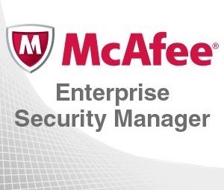
Integrations with RSA NW SecOps
RE
CEF, TCP/STCP
OOTB
RSA tested
Mapping file details provided to map incoming SIEM data to Archer fields
Non-OOTB (Other Integrations)
PS capable – Integrated in field
Mapping file details will need to be created
Unified Collector Framework (UCF) supports
Format
Syslog CEF messages or JSON
Transport
UDP, TCP, Secured TCP
RabbitMQ SSL
NetWitness
ESA
CEF, TCP
SAIM
JSON, RMQ
CEF, TCP
CEF, TCP
CEF, UDP
JSON, TCP/STCP
Notes:
Common Event Format – CEF
Secured TCP – STCP
JSON – JavaScript Object Notation

Slide 21
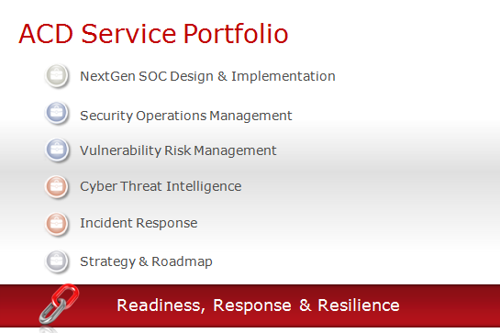
RSA Advanced Cyber Defense Services
Incident Response Rapid breach response & SLA-based retainer
Strategy & Roadmap Review and recommendations
NextGen Security Operations Technical consulting to transform from reactive to proactive
Notes:
KEY TAKEAWAY: ACD is a portfolio services to help you achieve security operations excellence
Strategy & Roadmap : services to identify current and target states of maturity, measure against peers and provide heatmap and priotized remediation measures.
Incident Response : represented by our Retainer, Discovery & Live Incident Response offers.
Retainer: an annual subscription providing the customer with proactive, SLA-driven rules for rapid, surge access to RSA resources and expertise should an incident occur.
Incident Response/Discovery: consulting services using NetWitness and ECAT for network and host analysis and forensic inspection to respond to known incidents (Incident Response) or to investigate suspect breaches (Incident Discovery). NetWitness is usually installed as part of a proof-of-concept with a PS charge for the Response/Discovery services.
Cyber Threat Intelligence represents workshops and consulting services for enhanced user awareness of APTs and zero day attacks. This includes review and guidance relating to hosted Cyber Crime Intelligence Services (CCI); monitoring of “hostile” domain names and IP addresses; processes and procedures for data enrichment using correlated rules and alerts; processes and procedures for malware analysis and reverse engineering; “big data” analysis capabilities, etc.
Vulnerability Risk Management: program for aligning business context with scan data enabling the prioritized remediation and management of workflow for vulnerabilities relating to IT assets.
Security Operations Management: program for aligning security controls with business context with a single pane of glass for the automation of incident handling workflow and breach management.
NextGen SOC Design & Implementation represents Critical Incident Response Center (CIRC) Technical and Operations consulting services. This includes all RSA products and core competency areas for Advanced Cyber Defense, including Incident Response, Authentication, IAM, SIEM, Network Monitoring and Forensics, DLP, Data Protection and GRC, etc. It can also include Identity Information Infrastructure consulting services that address policies, procedures, gap analysis and hardening guidelines for Authentication and IAM as they relate to Advanced Cyber Defense, including on-boarding, role changes, termination, standards, guidelines and workflows, etc.
Once the CIRC has been designed it must of course be implemented. RSA’s service offers for the implementation of the Technology and Operations model can be provided to the customer at that stage.

Slide 22
RSA Advanced Cyber Defense Services
Develop and mature a portfolio for ongoing competitive advantage
Incident Response
Retainer | Incident Discovery | Incident Response | IR Hunting Services
Breach Management
ASOC Design & Implementation
ASOC Strategy, Design & Program Development
Technology & Operations Buildout | Residencies, Support & Training
Security Operations Management
SecOps Strategy & Management | Use Case Development
Incident Response Procedures
Cyber & Counter Threat Intelligence
Program Development | Web & E-mail Threat Operations | Best Practices
Cyber Readiness & Capability Roadmap
Current State & Gap Analysis | Maturity Modeling | Breach Readiness Roadmap | Net Defender (Cyber Security Framework)
Notes:
Key takeaways
Drill-down on the services provided by ACD.
*****

Slide 23
TITLE

Slide 24
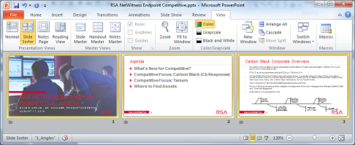
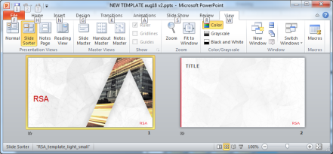
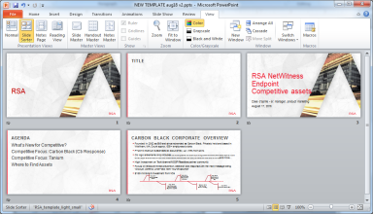
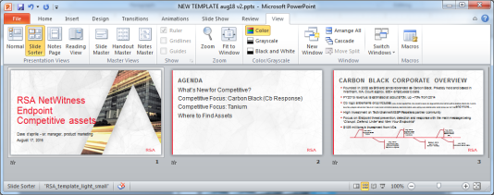
A SIMPLE WAY TO ADD THE NEW TEMPLATE TO YOUR PRESENTATION
Open your presentation > select Slide Sorter view > Select all > Copy
Open the file RSATemplateAug2016.potx > select Slide Sorter view
Place your cursor after the sample slides, then Paste. Your slides will take on the master of the preceding slide. Adjust any slides which did not convert by clicking on Layout and choosing the right layout.
Delete any unused master slides. Save your new file.

